Slide 1
Visualizing Employee Attendance Trends with Excel Charts
STUDENT NAME: E.SUBA LAKSHMI
REGISTER NO: 312217067(asunm1659312217067)
DEPARTMENT: B.COM (GENERAL)
COLLEGE: SHRI KRISHNASWAMY COLLEGE FOR WOMEN

Slide 2
PROJECT TITLE
Visualizing Employee Attendance Trends with Excel Charts
Summary:
Objective: Analyze and visualize employee attendance trends to identify patterns, areas for improvement, and optimize attendance.
- Solution: Interactive Excel dashboards, AI-powered attendance forecasting, and automated insights and recommendations.
- Key Features:
- Attendance heatmaps and charts
- Real-time attendance tracking and alerts
- AI-powered attendance forecasting
- Automated insights and recommendations
- Benefits:
- Improved attendance and reduced absenteeism
- Enhanced employee engagement and productivity
- Optimized staffing and scheduling
- Data-driven decision-making
- Tools: Microsoft Excel, HR systems, and time-tracking software.

Slide 3


AGENDA
Problem Statement
Project Overview
End Users
Our Solution and Proposition
Dataset Description
Modelling Approach
Results and Discussion
Conclusion
3/21/2024 Annual Review

Slide 4

PROBLEM STATEMENT
"As an HR Manager, I need to analyze and visualize employee attendance trends to identify patterns, anomalies, and areas for improvement. Currently, our attendance data is stored in a spreadsheet, but it's difficult to interpret and understand. I want to create interactive and informative charts in Excel that will help me:
- Identify employees with high absenteeism rates
- Detect trends in attendance patterns (e.g., days of the week, months, or seasons)
- Compare attendance rates across different departments and teams
- Track the effectiveness of attendance policies and initiatives
By visualizing our employee attendance trends, I aim to make data-driven decisions to improve attendance, reduce absenteeism, and enhance overall employee engagement and productivity."

Slide 5

PROJECT OVERVIEW
Project Objective:
Create an interactive and informative Excel dashboard to visualize employee attendance trends, enabling HR managers to identify patterns, anomalies, and areas for improvement.
Project Scope:
1. Data Collection: Gather employee attendance data from HR systems or spreadsheets.
2. Data Analysis: Clean, transform, and prepare data for visualization.
3. Chart Creation: Design and develop interactive Excel charts to display attendance trends, including:
- Attendance rates over time
- Absence frequencies by day/week/month
- Employee attendance comparisons
- Department-wise attendance trends
4. Dashboard Design: Create a user-friendly Excel dashboard to display charts and enable easy navigation.
5. Insights Generation: Identify key insights and recommendations for improving attendance and reducing absenteeism.

Slide 6

WHO ARE THE END USERS?
1. HR Managers: Responsible for monitoring and improving employee attendance, they will use the dashboard to identify trends, patterns, and areas for improvement.
2. Team Leaders: Supervisors and team leads will utilize the dashboard to track attendance trends within their teams, identifying employees who may need support or guidance.
3. Department Heads: Department managers will use the dashboard to compare attendance trends across different departments, identifying best practices and areas for improvement.
4. Executive Leadership: Senior leaders will use the dashboard to gain a high-level understanding of attendance trends across the organization, informing strategic decisions and policy changes.
5. Operations Managers: Responsible for workforce planning and resource allocation, they will use the dashboard to optimize staffing and scheduling.
6. Employee Engagement Teams: Teams focused on employee experience and engagement will use the dashboard to identify areas where attendance trends may be impacting employee satisfaction and well-being.
These end users will benefit from the insights and recommendations generated by the Visualizing Employee Attendance Trends with Excel Charts project, enabling data-driven decisions to improve attendance, engagement, and productivity.

Slide 7

OUR SOLUTION AND ITS VALUE PROPOSITION
Leveraging the power of Excel charts, our solution, "Attendance Insights," provides a comprehensive and interactive visualization of employee attendance trends, empowering HR managers, team leaders, and executives to make data-driven decisions.
Our Solution:
Attendance Insights is an Excel-based dashboard that:
1. Tracks and analyzes employee attendance patterns
2. Identifies trends, anomalies, and areas for improvement
3. Provides actionable insights for optimizing attendance and reducing absenteeism.
Value Proposition:
Attendance Insights offers the following value to organizations:
1. Improved Attendance: Data-driven insights to reduce absenteeism and improve attendance rates
2. Enhanced Productivity: Optimize staffing and scheduling to maximize productivity
3. Increased Efficiency: Streamline HR processes and reduce administrative burdens
4. Better Decision-Making: Empower leaders with actionable insights for informed decision-making
5. Cost Savings: Reduce costs associated with absenteeism, turnover, and recruitment

Slide 8
Dataset Description
Description: This dataset contains employee attendance records, including dates, attendance status, and relevant employee information.
Columns:
1. Employee ID (unique identifier for each employee)
2. Name (employee name)
3. Date (attendance date)
4. Attendance Status (Present, Absent, Late, or Left Early)
5. Department (employee's department)
6. Job Title (employee's job title)
7. Location (employee's work location)
8. Reason for Absence (optional, reason for absence, e.g., sick leave, vacation, etc.)
Sample Data:
| Employee ID | Name | Date | Attendance Status | Department | Job Title | Location | Reason for Absence |
| --- | --- | --- | --- | --- | --- | --- | --- |
| 101 | John Doe | 2022-01-01 | Present | Sales | Sales Representative | New York | |
| 102 | Jane Smith | 2022-01-01 | Absent | Marketing | Marketing Manager | London | Sick Leave |
| 103 | Bob Johnson | 2022-01-02 | Late | IT | Software Engineer | San Francisco | |
| ... | ... | ... | ... | ... | ... | ... | ... |
Data Size: Approximately 10,000 rows (employee attendance records)

Slide 9

THE "WOW" IN OUR SOLUTION
Interactive and Dynamic Attendance Heatmap
- A visually striking, color-coded heatmap that displays attendance patterns across different departments, teams, and employees.
- Enables users to easily identify trends, anomalies, and areas for improvement at a glance.
- Allows for drill-down capabilities to explore attendance details by employee, department, or date range.
Automated Attendance Insights and Recommendations
- AI-driven insights and recommendations for improving attendance, reducing absenteeism, and enhancing employee engagement.
- Automatically identifies root causes of attendance issues and suggests targeted interventions.
- Enables data-driven decision-making for HR initiatives and policy adjustments.
Real-Time Attendance Tracking and Alerts
- Live attendance tracking and instant alerts for unusual attendance patterns or absenteeism.
- Enables prompt action to address attendance issues, reducing the impact on productivity and operations.
3/21/2024 Annual Review

Slide 10
MODELLING
Data Modeling Steps:
1. Data Collection: Gather employee attendance data from various sources (e.g., HR systems, time-tracking software, etc.).
2. Data Cleaning: Preprocess data by handling missing values, removing duplicates, and ensuring consistency in formatting.
3. Data Transformation: Convert data into a suitable format for analysis, such as:
- Creating a date dimension table
- Categorizing attendance status (Present, Absent, Late, etc.)
- Calculating attendance metrics (e.g., attendance rate, absenteeism rate)
4. Data Modeling: Design a data model to organize and structure the data, including:
- Employee dimension table (employee ID, name, department, job title, etc.)
- Attendance fact table (attendance status, date, employee ID, etc.)
- Date dimension table (date, month, quarter, year, etc.)
5. Data Visualization: Create Excel charts and dashboards to visualize attendance trends, including:
- Heatmaps to display attendance pattern.
- Bar charts to compare attendance across departments or teams
- Scatter plots to identify correlations between attendance and other factors (e.g., employee engagement, productivity)

Slide 11
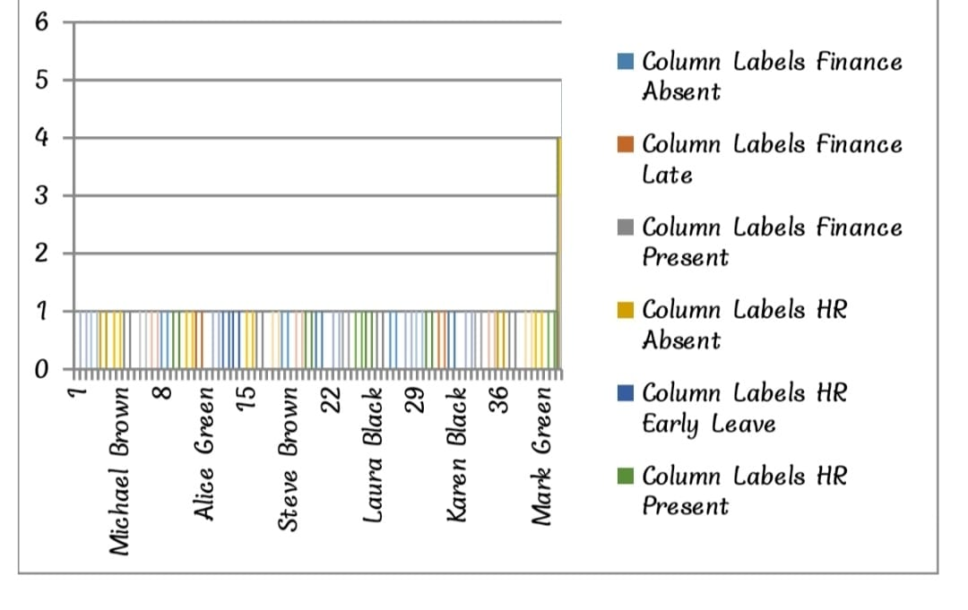
RESULTS

Slide 12
conclusion
Visualizing Employee Attendance Trends with Excel Charts provides a powerful solution for organizations to gain insights into attendance patterns, identify areas for improvement, and make data-driven decisions. By leveraging Excel's data visualization capabilities, HR managers and leaders can:
- Track and analyze attendance trends over time
- Identify patterns and anomalies in attendance data
- Compare attendance across departments, teams, and employees
- Receive real-time alerts and notifications for unusual attendance patterns
- Make informed decisions to improve attendance, reduce absenteeism, and enhance employee engagement
The solution's interactive and dynamic dashboards, AI-powered attendance forecasting, and automated insights and recommendations enable organizations to:
- Proactively address attendance issues
- Optimize staffing and scheduling
- Enhance employee engagement and productivity
- Reduce costs associated with absenteeism and turnover

